Slide 1
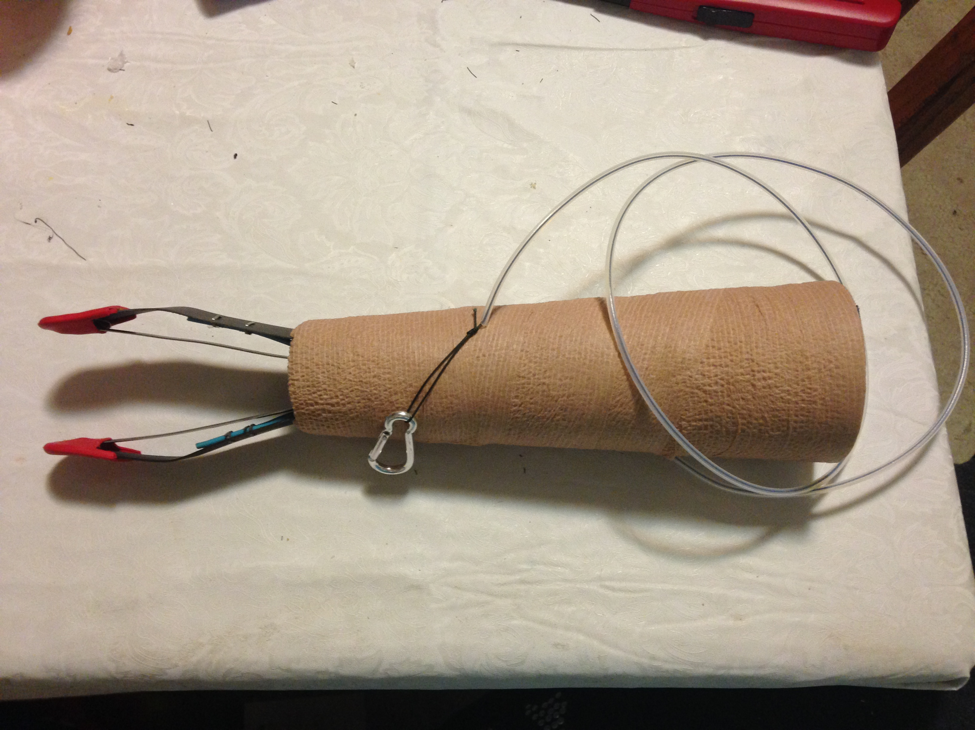
A New Arm
Hannah Moser- Marketer, Bailey Lidderdale- Physicist Jaide Bucher- Biomechanical Specialist, Erin Roth- Engineer

Slide 2
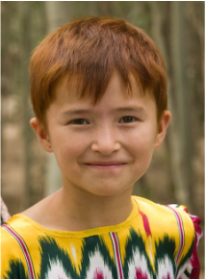
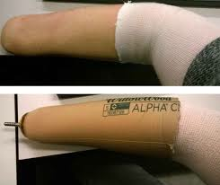
Who’s Joey?
Eight-year-old Joey lives with his family in rural Alabama. While he was a fetus, his umbilical cord became wrapped around his arm, cutting off the circulation and preventing his right arm from developing. He was born with a stubbed arm, meaning he had a partial arm below his elbow, but no hand. His family does not have insurance, and are not able to afford a prosthetic.

Slide 3

Why are we doing this?
Making affordable prosthetics is important because they can be very expensive. Often times, the people who need them the most can’t afford them.
If we were to make an affordable prosthetic that would help kids like Joey, it would help kids everywhere such as our very own team member Jaide.

Slide 4
Our prototype
Our prototype consists of a cardboard tube, a spring, grippers, 2 metal pieces, flexible rubber 1mm in diameter tubing with braided fishing line inside, a belt hook carabineer, Coflex bandage wrapping tape, leather, a couple screws, and two metal fingers.

Slide 5

How does it work?
The tube attaches to the belt loop on the user’s pants. If you push the arm away from you it pulls on the string closing the two fingers. If you pull it back toward your body it will release.

Slide 6
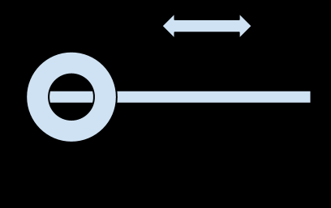
The physics behind the prototype
When the fishing wire is pulled in the tubing there is a tension force
When the fingers are pulled together there is a rotation on an axis meaning there is torque
There is friction between the stationary piece and the finger giving it limited mobility

Slide 7
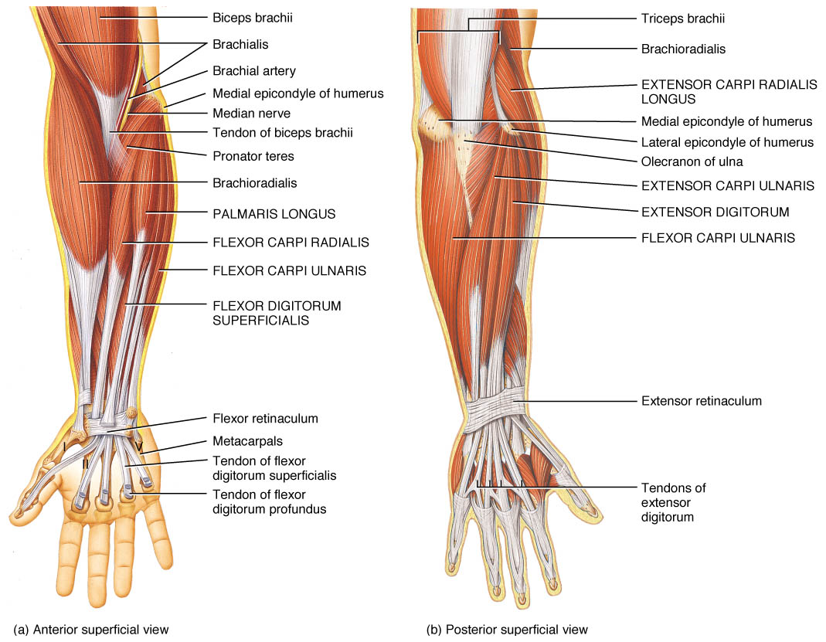
Biomechanics of our prototype
When the string is pulled it is showing flexion in the fingers
When the string is released it is showing extension
Our fishing line does the jobs of both the Flexor diagitorum profundus muscle and the Extensor Digitorum Muscle because it flexes and extends the fingers

Slide 8
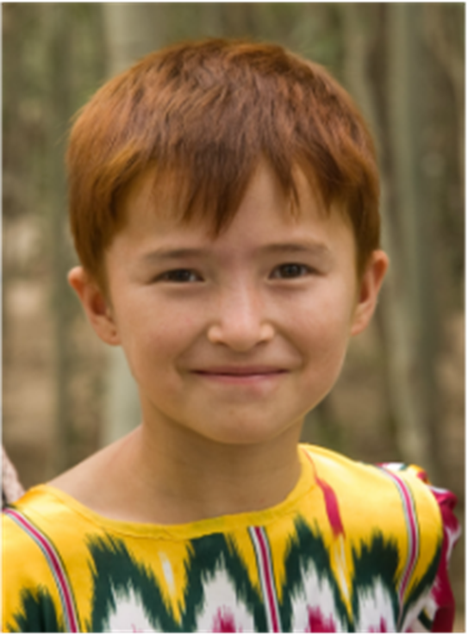
How we’re meeting Joey’s needs
We had a very affordable prosthetic
It is able to grow with him
It has Fine Motor/Pinch Dexterity
And is made from recycled materials

Slide 9

Materials and cost
Material | Cost
Carabineer | $0.45
CoFlex | $1.30
Leather | $10.00
Screws | $1.10
Staples | $2.00
Cardboard Tube | $5.00
Spring/Grabbers | $1.00
Plastic Tubing | $4.60
Braided fishing line | $2.00
We spent a total of… | $27.45

Slide 10
A decision matrix
Problem
Criteria
Evaluation (positives)
Decision
What is the opportunity cost
 | Weight (g) | Cost ($) | Appearance (does it look like skin?) | Recycled Material?
Silicone | 525cc=506 g | $10.00 | No | no
Coflex | 1 | $1.30 | Yes | no
Aluminum | 1m= 1632g | $15.00 | No | yes
Wood | 1m=20411g | $6.00 | No | no

Slide 11
Questions?

